Slide 1
Perspectives on Program Evaluation: Evolutionary Systems Evaluation
William M. Trochim
Cornell University
Lecture
prepared for the
National Centre for External
Evaluation of Education (NCEEE)
May 23, 2019
Zagreb, Croatia

Slide 2
What this presentation is not
An introduction to evaluation
A description of evaluation methods (except for some that make a point)
A set of examples of educational evaluations, or even STEM education evaluations
All of these things can be found elsewhere

Slide 3
Overview: What This Presentation Attempts
Challenge your views of evaluation
Re-think Foundational Issues
Systems Theory and Systems Thinking
Evolutionary and Ecological Evaluation
Evaluative Thinking

Slide 4
Beginnings: What is a “program”?
Things we do…
…in an organized way…
…in order to affect …
…outcomes
A set of activities…
…organized in a protocol…
…to cause…
…specific outcomes

Slide 5
Features of Programs
They usually have multiple components or activities
They are designed to be standardized, replicable
They occur in a real-life context
They are almost invariably adapted locally
They are usually only one causal factor among many
They typically aspire to affect many different outcomes

Slide 6
So, the following are some perspectives on programs that are designed to encourage you to think in a new and fresh way about program evaluation…

Slide 7
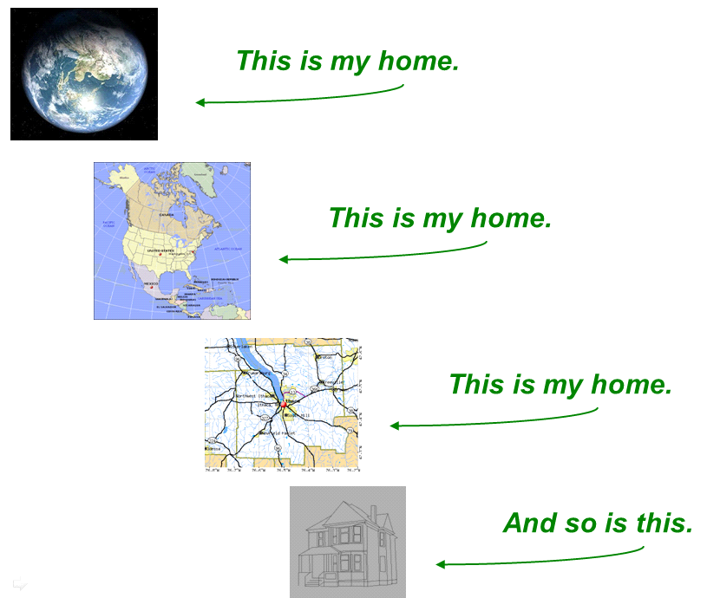
Local and Global
Systems Theory & Systems Thinking
Raises the question of “boundaries”
What is the “boundary” of a program?

Slide 8
Local and Global
Systems Theory & Systems Thinking
Family
School
Community
Class
Nation
Student &
Teacher
World
Programs exist in an hierarchical structure

Slide 9
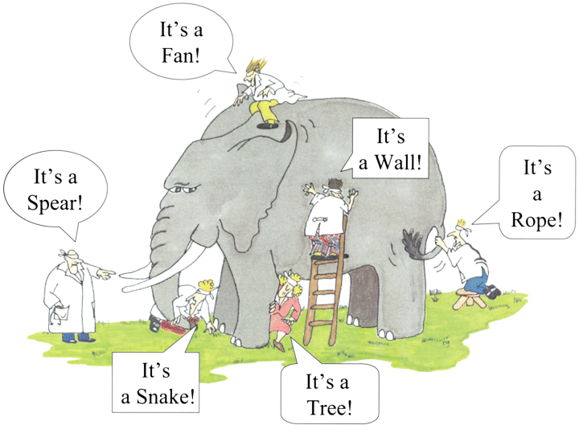
Multiple Perspectives
Systems Theory & Systems Thinking
Raises the issue of multiple stakeholders
A program can look different from different perspectives (the “eye of the beholder”)

Slide 10
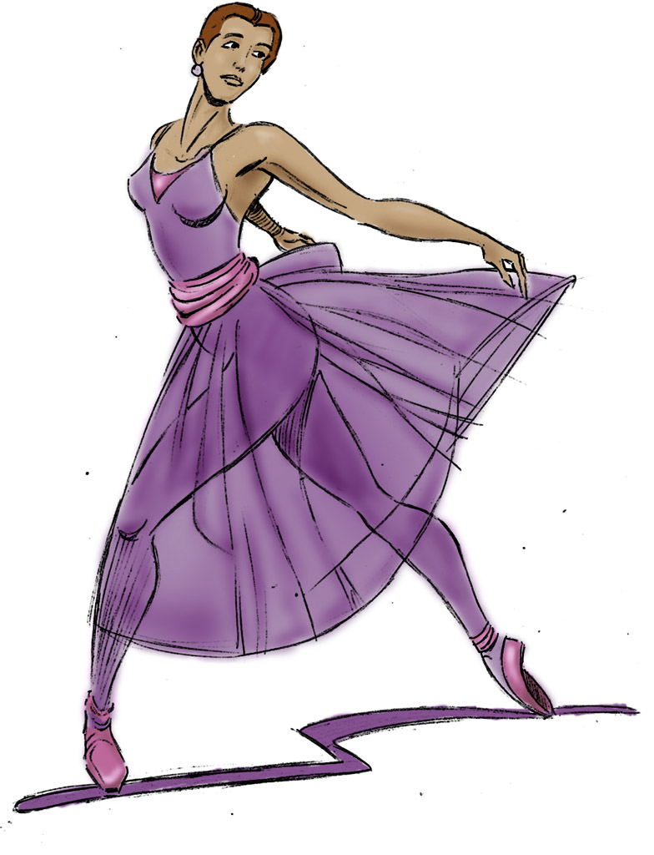
Part-Whole Relationships
Systems Theory & Systems Thinking
The “whole” is more than the sum of its parts
A program is more than the sum of its activities

Slide 11
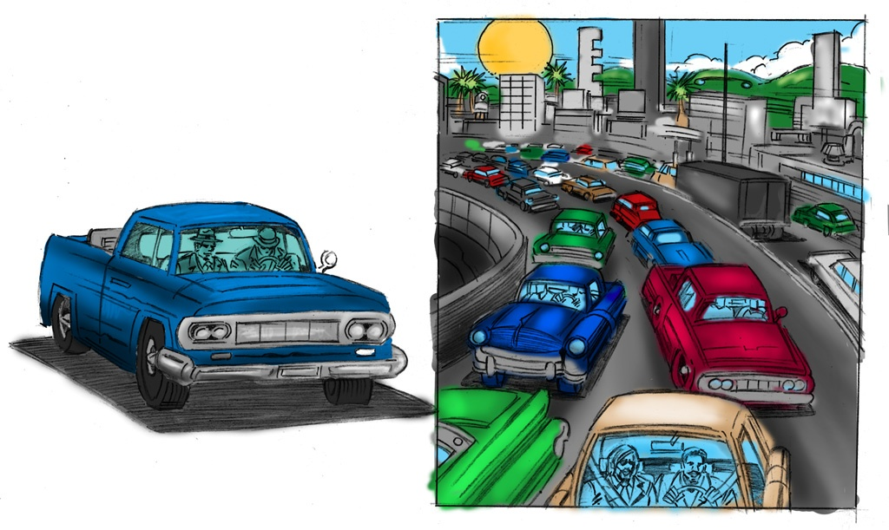
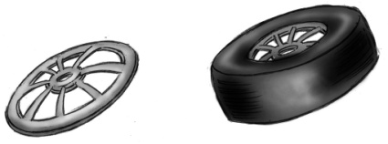
Complexity
Systems Theory & Systems Thinking
Complex
Complicated
Simple
When the parts of a program are put together we tend to see emergent complexity

Slide 12
Static and Dynamic Processes
Systems Theory & Systems Thinking
Static
Dynamic
Because programs involve people, they tend to be dynamic in nature

Slide 13
Simple Rules lead to Dynamic Complexity
Systems Theory & Systems Thinking
Separation - avoid crowding neighbours (short range repulsion)
Alignment - steer towards average heading of neighbours
Cohesion - steer towards average position of neighbours (long range attraction)
Wikipedia – Flocking Behavior
Suggests the idea of a “protocol” – a set of simple rules or steps that, when enacted, result in a complex structure.
Could this work for program evaluation?
Ants pick up grains at a constant rate (approx. 2 grains per minute)
Ants drop grains near other grains
Ants choose grains previously handled by other ants (probably because of marking by a chemical pheromone)
https://www.quantamagazine.org/ants-build-complex-structures-with-a-few-simple-rules-20140409/

Slide 14
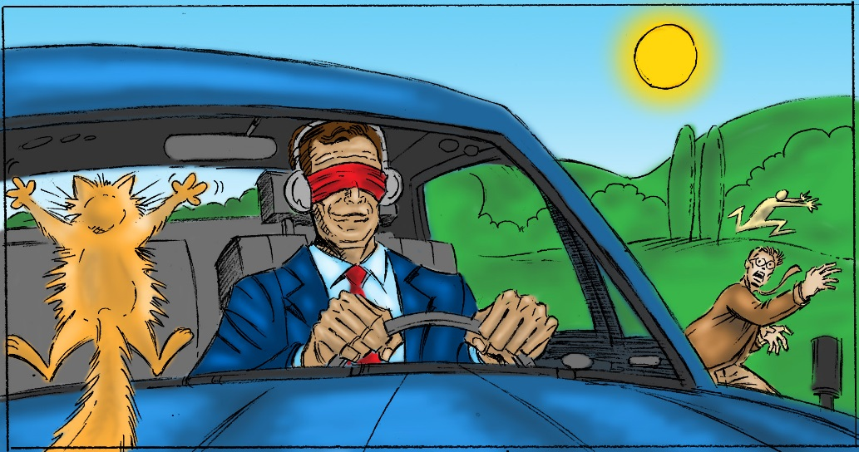
Feedback
Systems Theory & Systems Thinking
Typical experience – a program doesn’t think about evaluation (feedback) until near the end (i.e., drives “blind”).
Evaluation needs to be done from the beginning – including the development of the program model. Feedback works best when you anticipate you will need it.

Slide 15
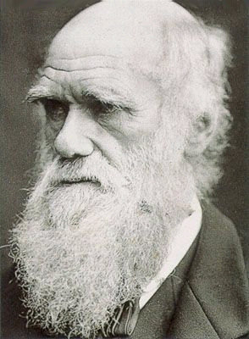
Evolutionary Systems
Evolutionary and Ecological Thinking
A program is an organism…
…in a population of varieties that constitute species
Program theories (stated or unstated) are the essential instructions (the DNA)
One potato
Potato varieties
Program variations are implemented, have consequences and are selected for in subsequent generations following the process of natural selection (blind variation and selective retention)
himself
Notes:
Every program that we evaluate is essentially an organism1 in a population of similar programs that constitutes its species. Program theories, whether stated explicitly or not, make up the essential instructions of the program. Within each program species there is variation. Programs have unique characteristics: the people who implement them, the activities that constitute them, the setting and assumptions that guide them, the participants who take part in them. This program variation is essential for their evolution.
Program variations are implemented, have consequences, and are selected for in subsequent program generations. Some programs, their characteristics and theories survive over time; most become extinct. Programs and program theories get selected and survive because of the fitness of their characteristics to a specific environmental or ecological niche. While most of us probably hope or believe that programs are selected for using rational criteria to yield specific desirable characteristics or outcomes, in many situations they probably survive because people like them, get used to them, or because there are institutional, political and economic forces that favor their survival.
Over time, programs and their theories evolve. This evolution is based on the same principle of natural selection that underlies all evolution in life. The process of consciously developing and evolving programs is a type of artificial selection, a special subtype of natural selection. Evaluation can play a key role in that artificial selection, both in encouraging and enhancing variability and in providing feedback and influencing selection. As in evolution generally, it’s not clear where program evolution is heading or whether any adaptation can be said to constitute ‘progress.’ Slight variations and adaptations can survive that subsequently make little apparent sense. Program features may exist today that were adaptive in the past but remain largely as residuals, long beyond their original adaptive genesis.

Slide 16
Evolutionary Systems
Evolutionary and Ecological Thinking
Natural Selection =
Blind Variation and Selective Retention (BVSR)
Campbell, D. T. (1974). Evolutionary Epistemology. In P. A. Schilpp (Ed.), The Philosophy of Karl Popper. LaSalle, IL: Open Court Publishing Co.
Blind Variation
Doesn’t mean the program is done “blindly” or without thought
It means we don’t know whether the variation will survive (work) when we initiate it
Selective Retention
Done by and in nature (includes the personal, emotional, socio-political system of choices)
Evaluation plays a critical role in both BV & SR
Variation generator – conceptualization and theory development
Selection role – is one factor in the selection process

Slide 17
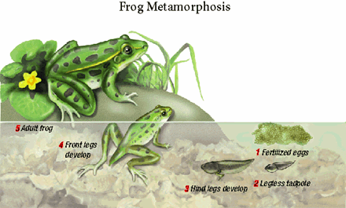
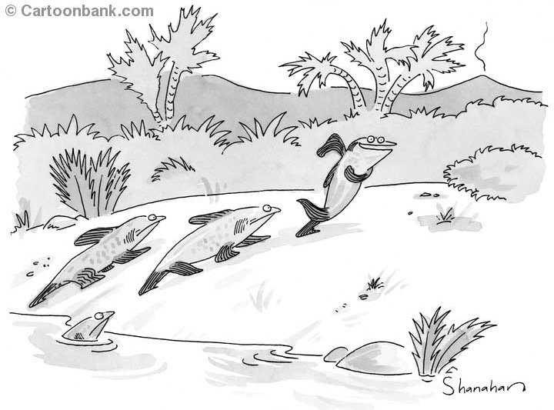
Evolutionary Systems
Evolutionary and Ecological Thinking
Every program has a lifecycle (ontogeny), a progression through phases or stages…
…over time there is an evolution of programs and program theories…
…and over time we can see the emergent evolutionary family “tree” (phylogeny) of programs and their theories
Notes:
Just as with other organisms in nature, in addition to their participation in a broader species, each program has its own individual life, a unique life course that moves through various phases. Programs are born or initiated. They grow and change as they are implemented and revised. They mature and may reach a relatively stable state sometimes becoming routinized and standardized. And, they regenerate, die, are translated and disseminated, and so on, starting new cycles of program instances.

Slide 18
Symbiosis and Co-evolution
Evolutionary and Ecological Thinking
Programs and their evaluation have a symbiotic relationship and co-evolve over time

Slide 19
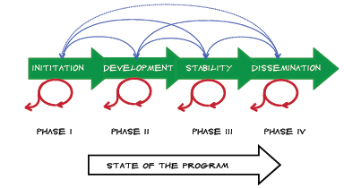
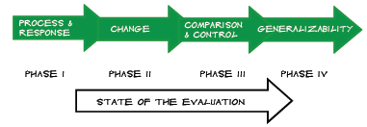
Evolutionary Systems
Evolutionary and Ecological Thinking

Slide 20
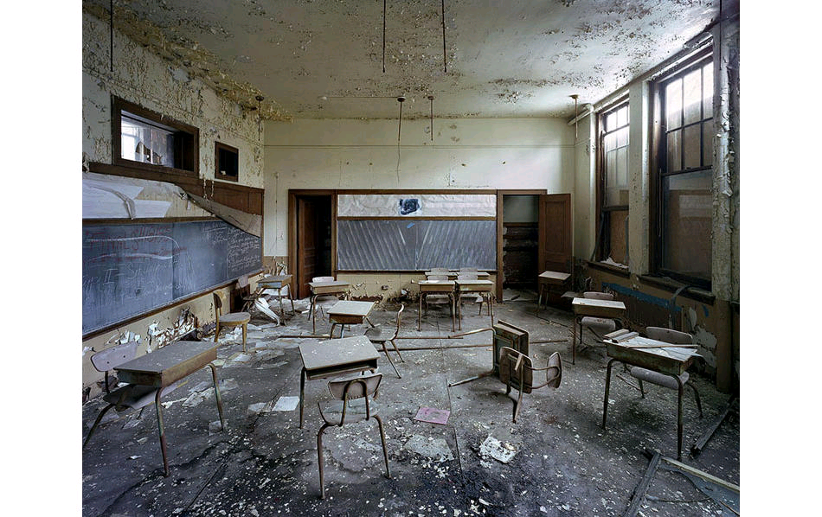
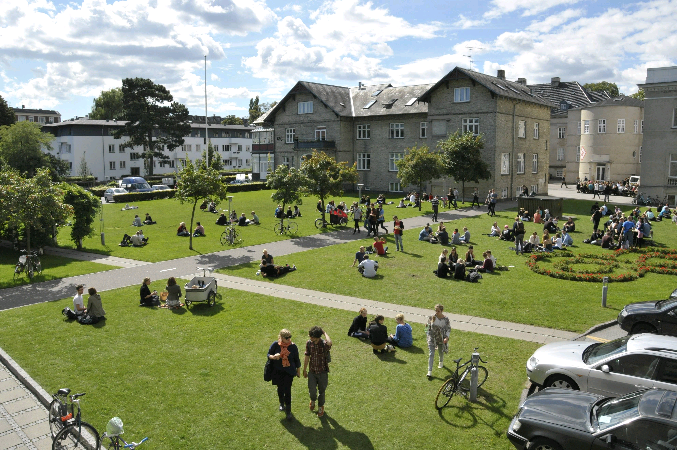
Context and Ecology
Evolutionary and Ecological Thinking
The ecology of a school matters
Would the same program function the same way in different ecologies?

Slide 21
Evaluative Thinking
Evaluative Thinking
Definition
Evaluative thinking is critical thinking applied in the context of evaluation, motivated by an attitude of inquisitiveness and a belief in the value of evidence, that involves identifying assumptions, posing thoughtful questions, pursuing deeper understanding through reflection and perspective taking, and informing decisions in preparation for action.
Buckley, Jane, Archibald, Thomas, Hargraves, Monica, & Trochim, William M. (2015). Defining and Teaching Evaluative Thinking: Insights From Research on Critical Thinking. American Journal of Evaluation, 36(3), 375-388.

Slide 22
Evaluative Thinking
Evaluative Thinking
Put another way:
critical thinking
in context of evaluation
motivated by
attitude of inquisitiveness
belief in the value of evidence
involves:
identifying assumptions
posing thoughtful questions
reflection and perspective taking
informing decisions in preparation for action

Slide 23
Summary – Evolutionary Systems Evaluation
Systems Theory
Greater than the Sum - Part-Whole Relationships
The Local and the Global - Scale
Inside-Outside – Boundaries
The Eye of the Beholder - Multiple Perspectives and Stakeholders
Context - Ecology
Complexity and Dynamics
The Rock and The Bird - Static and Dynamic Processes
Simple Rules - Complexity and the Idea of a Simple Rules (Protocol)
Driving With Your Eyes Open - Feedback
Evolution & Ecology - The Survival of Programs with “Fitness”
In the Course of a Lifetime – Ontogeny
It’s All in the Family - Phylogeny
The Flower and the Bee - Symbiosis and Co-Evolution
Evaluative Thinking

Slide 24
Implications of Evolutionary Systems Approach
Evaluation needs to involve multiple stakeholders and perspectives
The role of context is essential for a program
Evaluation needs to be prospective not just retrospective
Program models are necessary for good evaluation
Program variation is good; Avoid program monocultures
Evaluation protocols (simple rules) help
Address dynamic complexity
Assure quality

Slide 25
For further information
William Trochim
Cornell University
wmt1@cornell.edu
https://core.human.cornell.edu/

